Slide 1
APLICACIÓN DE PATRONES
PRESENTADOR:
Gerson Stick Barrera Delgado 1151207
Gino Amaury Gongora Capacho 1151215
Jesús David Pabón Ortega 1151223
William Schnaider Torres Bermon 1151232
Asignatura: Patrones de Diseño
Semestre: Octavo

Slide 2
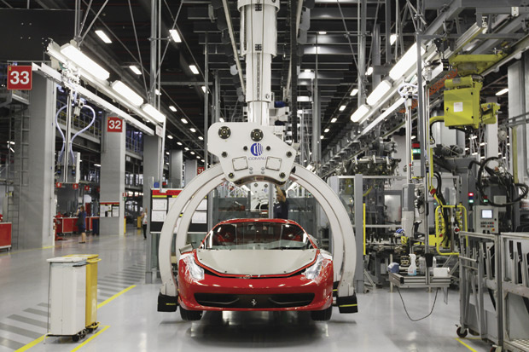

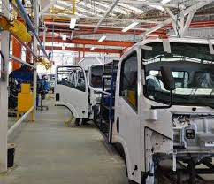
Fabricate needs to carry out a virtual test with different strategies on its vehicles models, where the behavior with different types of engines was evaluated, in order to be able to select the appropriate engine according to its specific use on different scenarios, the company at the beginning only handled one type of vehicle, but with the expansion of the market you have decided to launch another vehicle for sale, it is required that this virtual test work later for the full range of vehicles to launch in the future and the full range of engines that manages the organization.

Slide 3
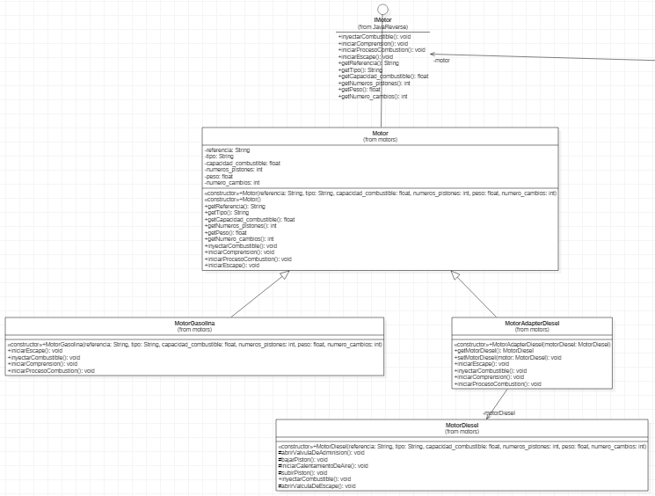
PATTERNS
ADAPTER:

Slide 4
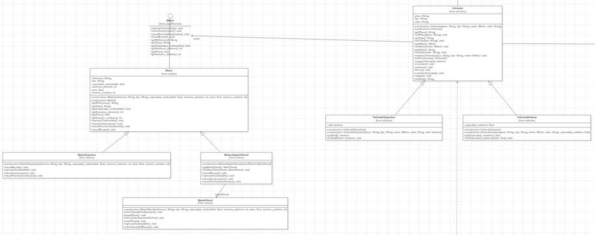
PATTERNS
BRIDGE:

Slide 5
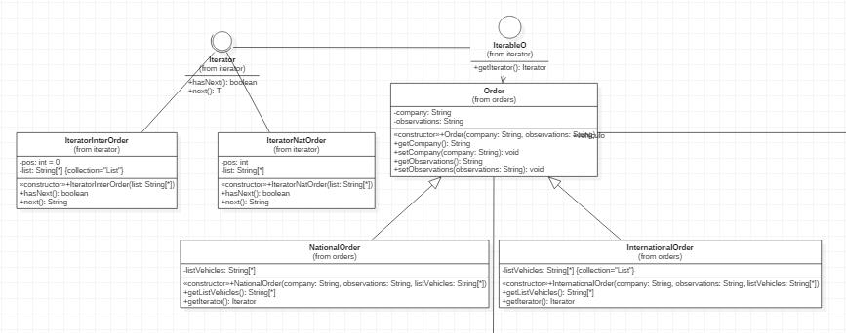
PATTERNS
ITERATOR:

Slide 6
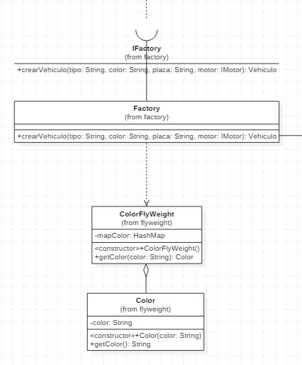
PATTERNS
FACTORY AND FLYWEIGHT:

Slide 7
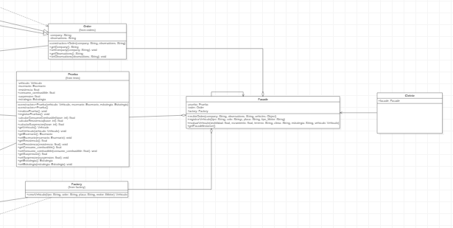
PATTERNS
FACADE AND SINGLETON:

Slide 8
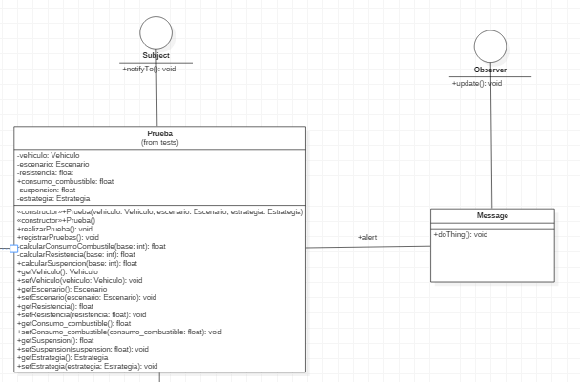
PATTERNS
OBSERVER

Slide 9
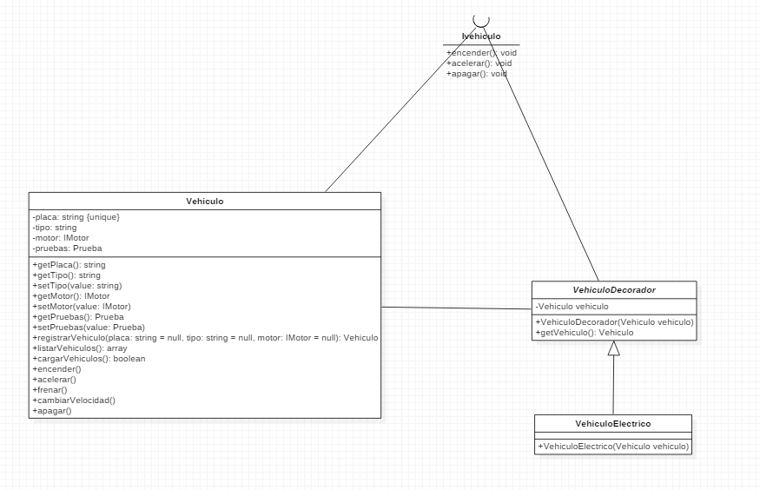
PATTERNS
DECORATOR

Slide 10
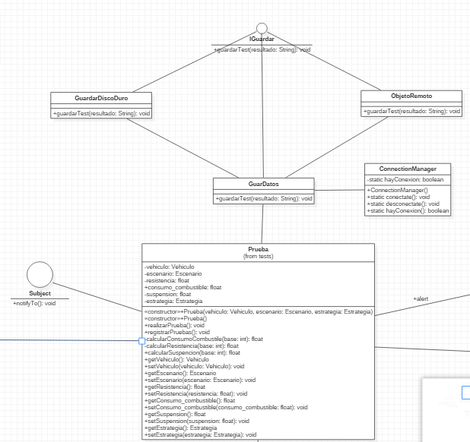
PATTERNS
PROXY

Slide 11
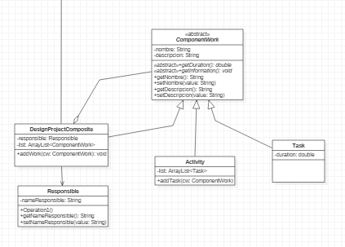
PATTERNS
COMPOSITE

Slide 12
Gracias

